Slide 1

Smart Brevity
How to structure your message for optimal readership.
WFJOB#-BU-CAT-Project-Name
Month XX, 2022 | Round 1
2023

Slide 2
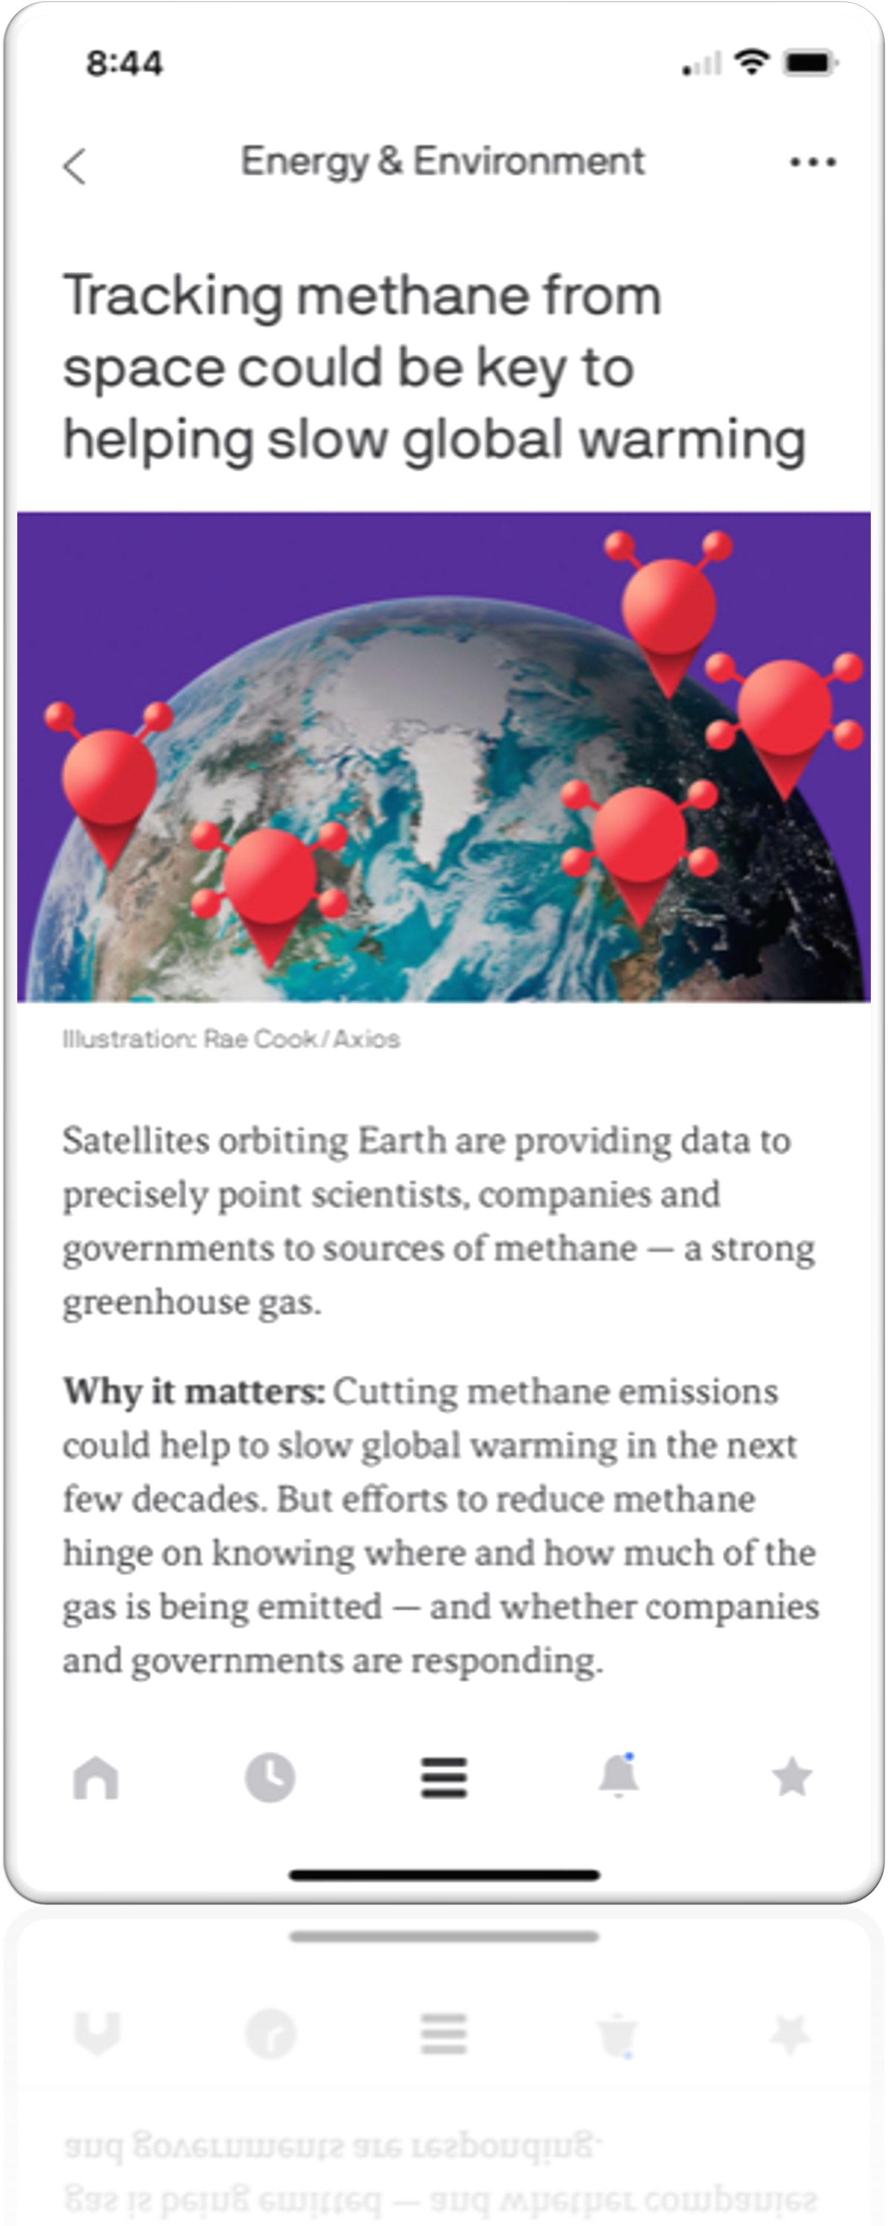

Maximizing Readership
Deliver worthy information in a structured way.
Start with what’s new + why it matters
Three key critical elements:
Scan ability
Comprehension
Recollection
Considerations:
People rarely read more than a few paragraphs - 70% want shorter comms (according to Gallup)
Readers have high expectations for the time they give you – 1/3 of emails that require attention go unread
Readers want to know what’s new + why it matters – 5% finish a typical, 800-word article
Reminder: Length is fear, brevity is confidence
Headline
What’s new
Why it matters

Slide 3
Structuring Content
Headline: The title of your article
Sentence case
Cap them around 60 characters (10 words) — It’s highly memorable for fast-moving readers.
Keep them concrete — 59% of readers share a link without ever clicking it. Teach them something.
Use short, simple words — It keeps your content conversational and easy to consume.
What’s new: The first sentence of your update that tells your reader something essential.
Keep it to one sentence — If you can guarantee readers remember one thing, make it this.
Make it distinct — Avoid repeating information or phrases that exist in your headline.
Stay conversational — How would I say this to a friend or colleague?
Why it matters: The critical context that explains how this news impacts your reader.
Stay brief — Try to answer this in one, tight sentence, too.
Keep that smart reader in mind — Why does this matter to them, specifically?
Don’t force it — If it doesn’t matter to that reader, stop writing and move on to something else.
Style for impact: The rest of your text should be digestible and scannable to boost retention.
Bullets break up blocks of text and create easy-to-skim lists.
Bolding amplifies key points and pulls readers deeper into the update.
Links provide access to related resources and deeper analysis — all in service to the reader.
For newsletters, we recommend each article be no more than 100 to 150 words.

Slide 4
Example
Before:
After:
2G Network Initiative (Autostore Box Build)
During the week of 1/15/2023, the 2G network conducted the first network kaizen event, which had leaders from all sites in participation. AVP2 and RNO1 sent leaders to work with MCI1, who hosted the event. Their goal was to tackle network barriers within in their Autostore Box Build indirect process. This included reviewing staffing practices that MCI1 was implementing due to their lower percentage ratio of indirect staffing (42.7%), wasted time in transportation of pre-built boxes to pickers’ box suites, and box suite layout out for material replenishment. Additionally, the kaizen team put UPLH impact of actions implemented from the event in-scope of their project.
Prior to the event, the box build process looks like this: a box builder retrieves boxes from designated corrugate staging, box builder builds the box and puts through taper (like 1G induction box build), built boxes are manual stacked and staged by box size, a waterspider moves stacked boxes from staged location onto a flatbed cart, and then they transport and replenish boxes where needed. Box builders averaged 827.5 CPH and waterspiders travel time ranged 4-6 minutes checking eight picker box suites. Additional factors that contributed waste to the process were: boxes staged in box suites horizontally (1 stack), lack of Kanban system to notify waterspiders of boxes that needed to be replenished, transportation cart design allows boxes to fall over/off, and lack of availability of high frequency boxes causing pickers to retrieve their own boxes. The boxes staged horizontally presented wasted capacity potential in the box suites, which if optimized could reduce waterspider touches. The boxes stacked on carts not being stable on the cart causes waterspiders to utilize 65% of the capacity of the cart.
By the end of the event, the kaizen team was able to demonstrate several actions that drove indirect percentage down and improve picker rates by 30-40 UPH! Through the new staffing model for box build, the kaizen team saw box builders operating at 1,013 CPH (22% increase), as well as water spider total cycle time reduced to 2-4 minutes. Within this week, they were also able to trial a redesign of the box suite that increased pre-built box capacity by 40%, test a different transportation container (black bin) that allowed for enhanced stability, and standardize recommended indirect staffing recommendations to bring the network to operate at 42.7% indirect rate.
This event was hosted at MCI1 (Belton, MO) and lead by: Ezra Loeblich (MCI1 OM), Taylor Bell (MCI1 AM), Angel Leon (RNO1 OM), Nick Brunozzi (AVP2 AM) in sponsorship of Haley Miller (SPM – West/2G), Olivia Trinca (SCM MCI1), Kal Manda (SCM AVP2), and Byron King (SCM RNO1). The team also consisted of MCI1 Leads - Yomira Valdez Garcia and Eric Perryman – as well as team members/problem solvers – Searcy Mitchell and Ember Smith. Also, kudos to Kaustav Das (MCI1 OM) who collected pre-work data and time studies.
We look forward to MCI1’s complete transition and the glide path for AVP2 and RNO1 for replication!
New Autostore Box Build Initiative
Recently, the Kaizen Team conducted the first network kaizen event at the MCI1 fulfillment center. The team was able to uncover new ways of lowering indirect average and improving picker rates (30-40 UPH)!
The team was also able to:
Redesign a new box suite that increased capacity by 40%,
Test different transportation containers for enhanced stability
Standardize indirect staffing recommendations to achieve and operate at a 42.7% indirect rate
Stay tuned for more updates as the team continues to develop and share ways to improve!
Headline
What’s new
Why it matters
*bullets to breakup content

Slide 5
Do’s and Don’ts
Do:
Spell out acronyms
Use oxford comma
Use sentence case for titles
Select the details most relevant and interesting to that audience
Share new information that provides essential context
Be concise
Use bullets, bolding and italicizing to style
Write like a human
Conversational, use short, simple words with energy and impact
Authentically and relatable
Don’t:
Use acronyms, and if you use them, always spell out the word the first time you write it
Example: Human Resources Business Partner (HRBP)
Avoid jargon and pet puns
Write tactically
Write dense and long paragraphs
Include unrelated information – it’s better to exclude than waster reader's time

Slide 6


Tools and Resources
Here is the Brand Editorial Guide
Here is the writing checklist.
Make sure to bookmark these links for easy access!

